Slide 1
Why Agile
For Faster Development , Nowdays Every Popular Companies Like Facebook Are Using Agile Methodology
Nowdays Development Is Going On Rapidly If We Will Take One year Time To Develop Product And After That We Will Release It Then Until That Time New Technologies Will Appear Hence Instead Of That We Will Develop Product Rapidly And Release It And After That We Will Make Changes To It As Reuired
Agile Will Help In Customer Satisfaction As In Agile Continuous Customer Feedback Was Taken .
Higher Quality Of Product

Slide 2
What Is Scrum
Scrum Is Framework Which Implements Agile Methodology
In Scrum Framework We Will Get Customer Requirements Which Is Known As Product Backlog In Scrum Framework
This Product Backlog is Divided into small pieces of work which is known as spring backlog and on that team of 5-9 people will work.
In scrum framework there is no levels on people like manager , developer like that every person in scrum will be treated as same level person . Everyone can do any work.
In scrum daily 10-15 min stand-up meeting will happen . In that what did you done yesterday , today and what are the problems you are facing in doing that will be discussed
In scrum after 1-2 weeks some work submission will be done which is known as increment . This time of submission is depends upon the speed of team . But it will be not more than 2.5 weeks .

Slide 3
Role Of Product Owner And Scrum Master
Product Owner Will Give His Requirements Like UI , What Functionalities He Wants To Be Included in his product .
Product Owner Will Prioritize The Work Which Should Be Done First .
Product Owner Will Tell The Deadline Upto Which He Wants His Product
Owner Will Give Review After Every increment.
Scrum Master Will Solve The Problems Which Will Occur Development Process . He Will Tacle The Obstacles Which Will Come in The Way of meeting the goals .
Scrum master is only the connection between the scrum team and people outside of scrum team.

Slide 4
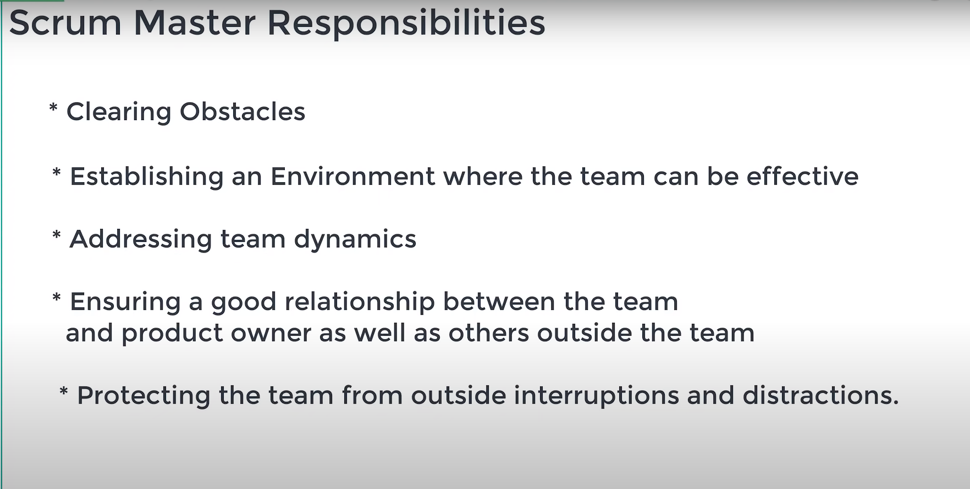

Slide 5
Documents produced in scrum
Product Backlog
This Is The Document In Which All The Product Owner Requirements Are Present
Spring Backlog
This Can Be Maintained(Edited) By Any Member Of scrum team .
Basically It is the division of product backlog into small parts of work.
Burndown Chart
This Is the chart will will Tell That How Much work is done and is it as per The Estimation or not .
One Estimation Line will be there

Slide 6
What is the Agenda of Sprint planning, daily scrum and sprint retrospective meetings
Spring Planning Meeting is for discussions about the ultimate objective of the sprint and the team's capacity
In Daily Scrum Meeting Progress and roadblocks will be discussed .
Spring retrospection is to analyze and improve the team performance . And is it as per the Product Owner Or Not

Slide 7
